Slide 1
Conventional wisdom is an oxymoron: teach / learn a curriculum ! THAT BUSINESS HIRES ! An UBER for Learning is a metaphor for Education On Demand A weapon of mass instruction vogu^{id}e

Slide 2

The Missing IDEAs in Edtech: Inclusion, Diversity, Equity & Access

Slide 3

Knowledge Skills Attitudes

Slide 4

Transition from training to Performance Shift from courses to resources

Slide 5
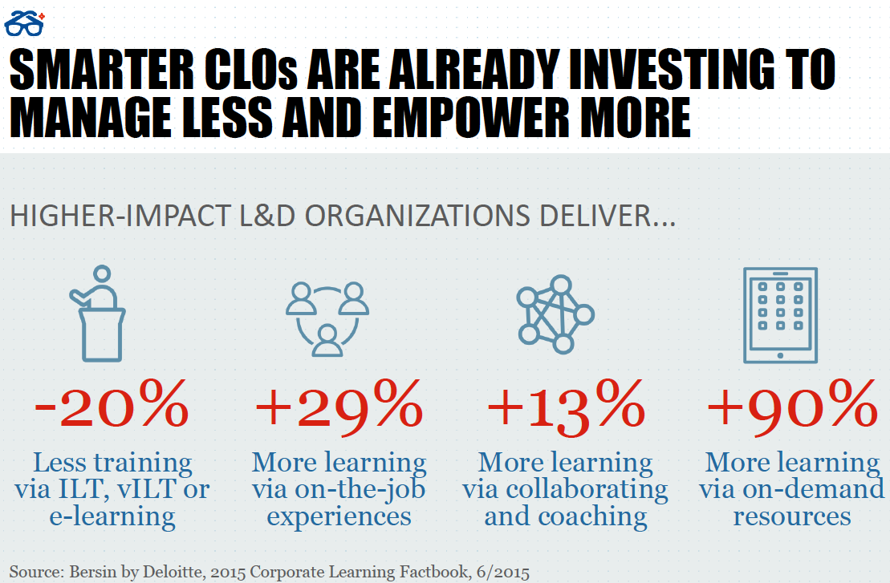
Instructional Design is a dying art

Slide 6
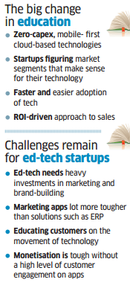
Make the most of existing content

Slide 7
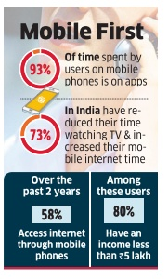
By 2020, India will have the world’s largest tertiary-age population, and the second largest graduate talent pipeline globally

Slide 8
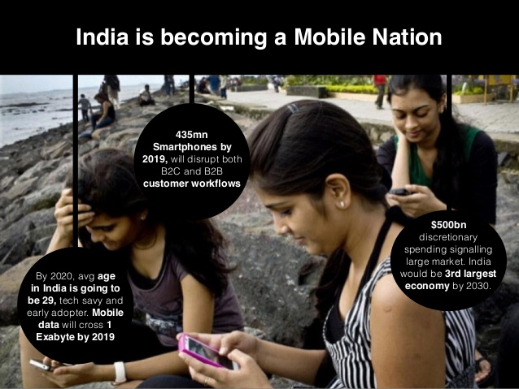
The education market in India, which is presently worth around Rs 5.9 trillion (US$ 92.98 billion)

Slide 9

“It isn’t about imposing solutions, but helping the community surface the solution it already has” - Jane Bozarth

Slide 10

Ovewhelming Content Syndrome - Break content silos

Slide 11
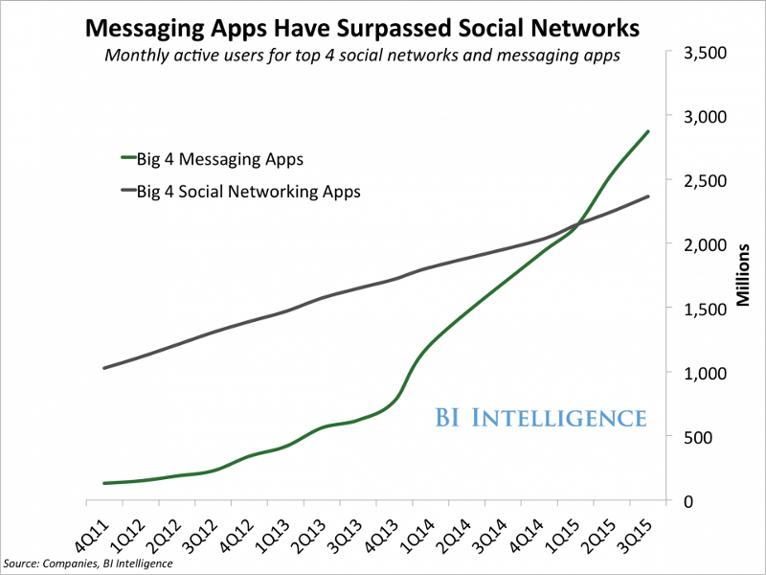
Wait-Learning | Commute-learning

Slide 12
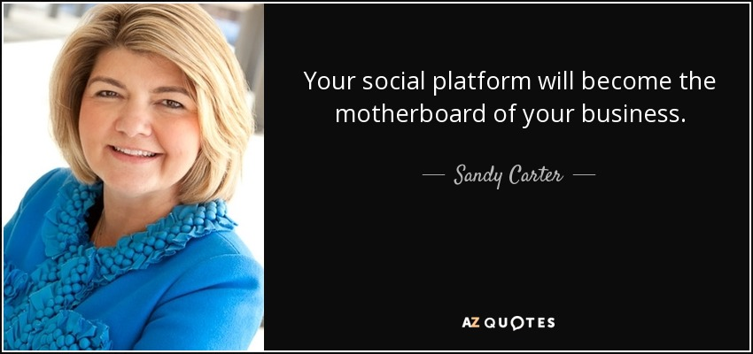

Slide 13
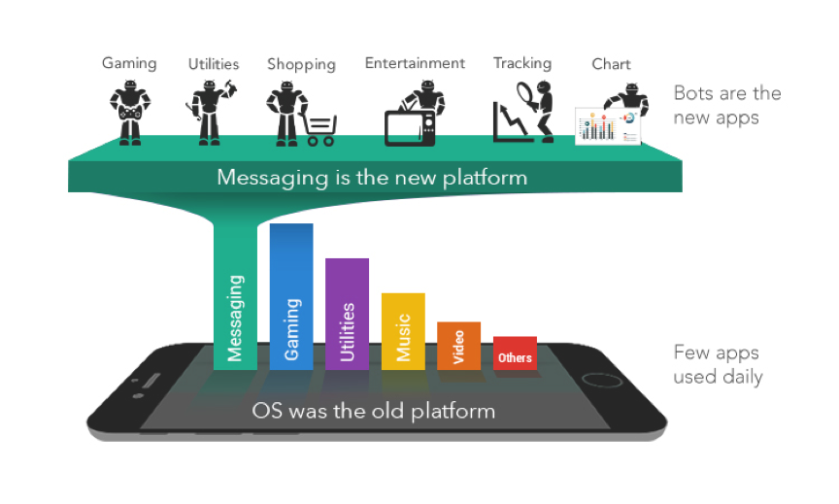
high opportunity low cost low capex low opex low burn rate

Slide 14
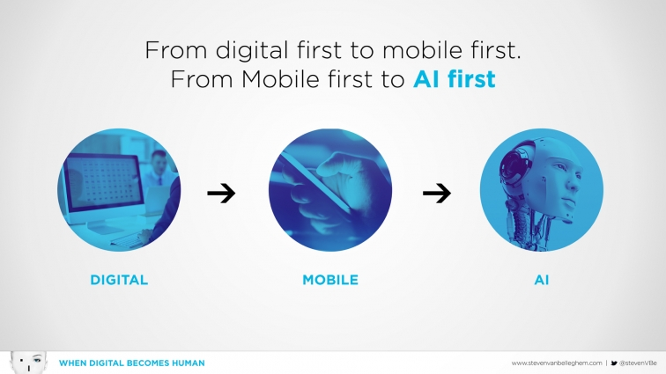

Slide 15
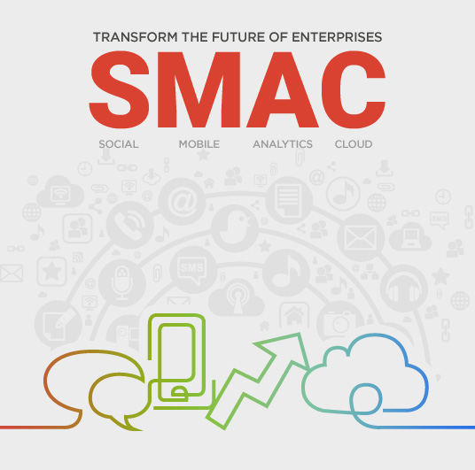

Slide 16


Slide 17

Future of EdTech: Platforms, Machine Learning, Personalisation, IOT, VR - but all connecting to the human element of learning!

Slide 18
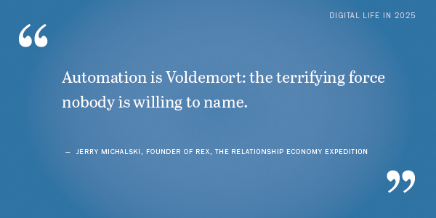
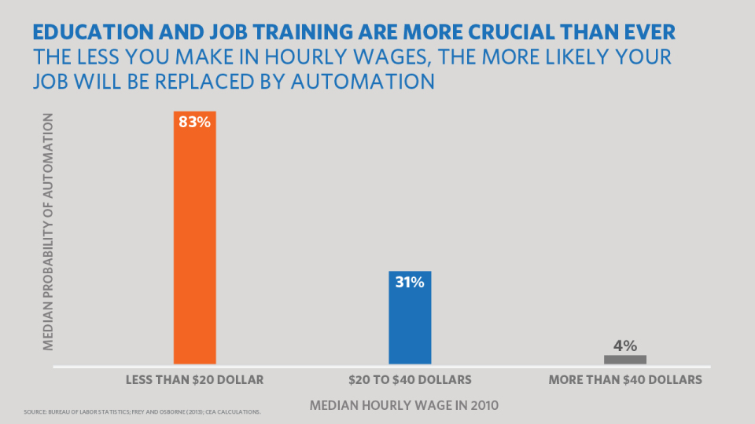

Slide 19
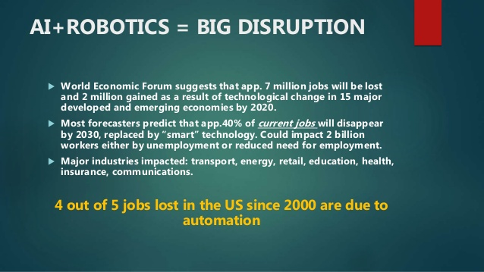

Slide 20
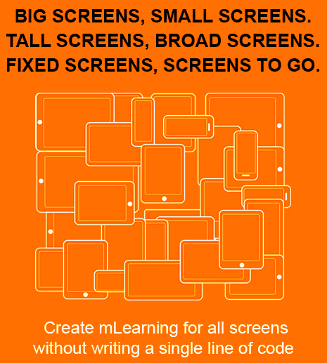
DYOL - Do Your Own Learning

Slide 21
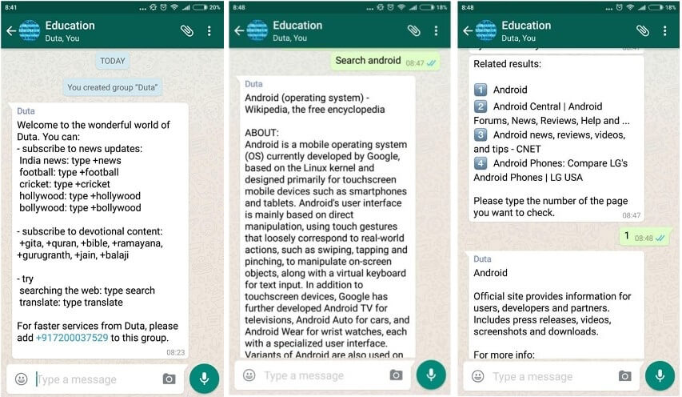
The Solution ?

Slide 22
Our DNA: Heutagogy / Autodidactism Design Thinking SMAC SAMR extended enterprise training Reducing Trainer dependancy

